Slide 1

DAL-XSD: XML schema proposal
Date: 2013-12-11
DMS#:
Author: Simon Merrall, Andreas Sayegh
Company: Deutsche Telekom
For working group: SHTF
For document: GWD042

Slide 2

Licensing
  This is a contribution to GWD042, which is aimed to be published by HGI under royalty free license conditions (e. g. Apache License).
  The author(s) hereby confirm their awareness that this contribution may become a part of an HGI publication under royalty free licensing.
  Warning: Any further work on this contribution will also become part of a royalty free licensing.

Slide 3
Purpose & Actions
  This contribution proposes a draft for an XML schema that describes device type capabilities
  The schema encourages modular approach
  We‘d like the HGI adopts the schema as a starting point and starts to work on its finalization

Slide 4
Some Guiding Principles
  Device description is in XML
  Try to avoid becoming too complex
  Mechanism for referencing other definitions required
  Rely on standard XML semantics
    Description should be a valid XML document
    Do not introduce additional semantics
    (e.g. <import-device id="…"/>)
    Use of standard XML tools (parser, XSLT) should be possible
  Identify unit of re-use and abstraction
Not addressed: Standard dictionary for terms such as power, light, etc.

Slide 5
Namespace Declarations
Schema
<xs:schema targetNamespace="http://hgi.org/xml/dal/1.0"
xmlns="http://hgi.org/xml/dal/1.0"
xmlns:xs="http://www.w3.org/2001/XMLSchema"
elementFormDefault="qualified">
<xs:import namespace="http://www.w3.org/XML/1998/namespace"
schemaLocation="http://www.w3.org/2001/03/xml.xsd"/>
  An XML Schema
  Using some standard XML elements
    Needed for imports

Slide 6
Imports
  Ideally the descriptions build on standard definitions
Schema
<xs:group name="Imports">
<xs:sequence>
<xs:element minOccurs="0" ref="Imports"/>
</xs:sequence>
</xs:group>
<xs:element name="Imports">
<xs:complexType>
<xs:sequence>
<xs:element minOccurs="0" maxOccurs="unbounded" ref="Domain"/>
</xs:sequence>
</xs:complexType>
</xs:element>
  Schema provides Imports tag for importing one or more Domain definitions
  Imported Domain is part of document – not merely a reference

Slide 7
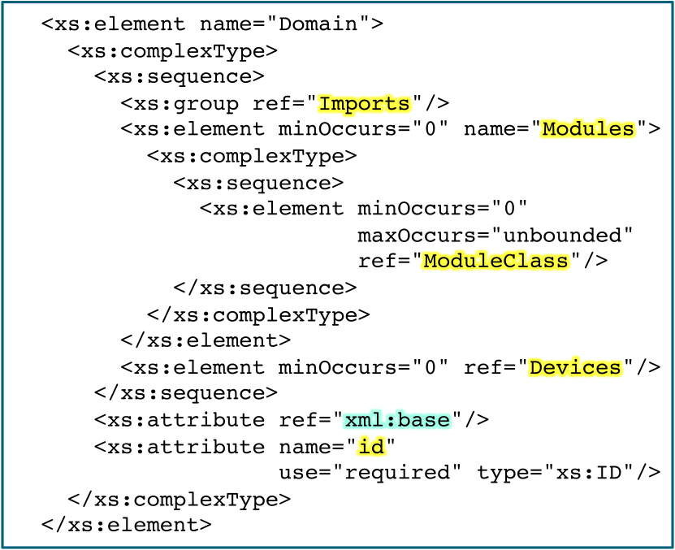
Domains
  Multiple device descriptions are collected in a Domain
Schema
  Domain has a unique
  id and consists of:
  Imports section
  Modules section
  containing
  ModuleClasses
  Devices section
  xml:base tag needed for compatibility with xincludes

Slide 8
Example Domain Declaration
  Device Descriptions are XML Domain Documents
Document
<?xml version="1.0" encoding="iso-8859-1"?>
<Domain xmlns:xi="http://www.w3.org/2001/XInclude"
xmlns="http://hgi.org/xml/dal/1.0"
id="com.telekom”>
<Imports>
<xi:include href=”http://hgi.org/dal-core.xml" parse="xml" />
</Imports>
...
  The default namespace is bound to the HGI-DAL Schema
  The Domain defines a unique id
  Imports are realised using standard XML includes
    Namespace for XML Includes must also be declared
    Domain documents can be included in the Imports section
    Modern standard XML tools are xinclude aware

Slide 9
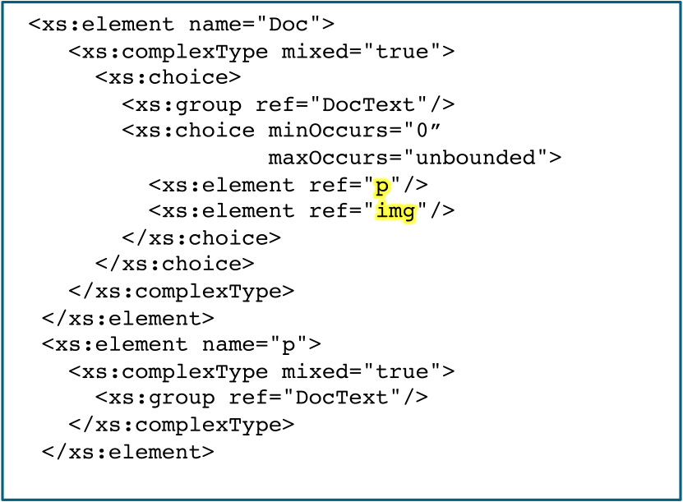
Documentation
  Small HTML-style tag-set for documenting the defintion
Schema
  Consists of paragraphs
  and images
  DocText group
  provides mark-up
  for emphasis etc.
  If there is only one
  paragraph the tag
  can be omitted

Slide 10
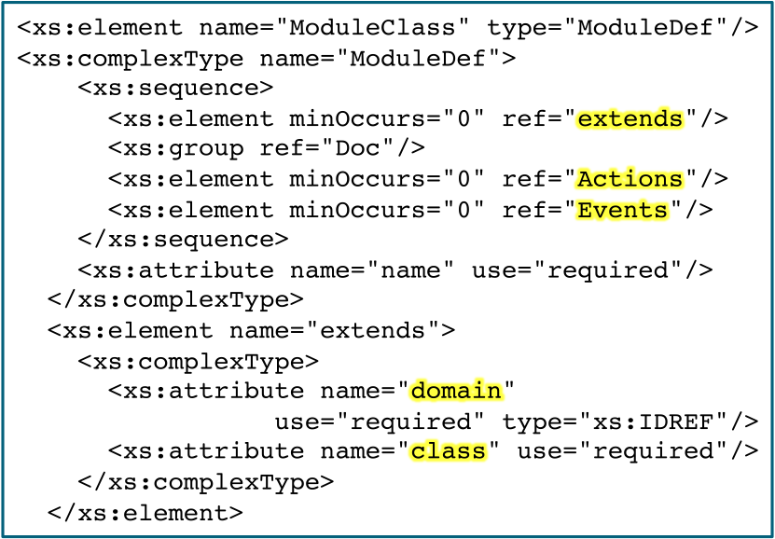
Domain Modules
  Reusable elements are declared in the Modules section
Schema
  ModuleClass consists of:
  Name – unique in the
  Domain
  Actions section
  Events section
  Can extend another
  module referenced by
  Domain id (must be
  included)
  ModuleClass name
Do not use globally unique identifiers for module classes – Domain should act as a scope.

Slide 11
Example Module Class
  BooleanState for modelling underlying binary state
Document
<ModuleClass name="BooleanState">
<Doc>…</Doc>
<Actions>
<Action name="get" type="boolean">
<Doc>
Obtain the current associated state.
</Doc>
</Action>
<Action name="setTarget">
<Doc>
Obtain the current associated state.
</Doc>
<Arg name="value" type="boolean">
<Doc>
Desired value of the associated state.
</Doc>
</Arg>
</Action>
</Actions>
</ModuleClass>
  Provides operations
  for reading and
  setting the state

Slide 12
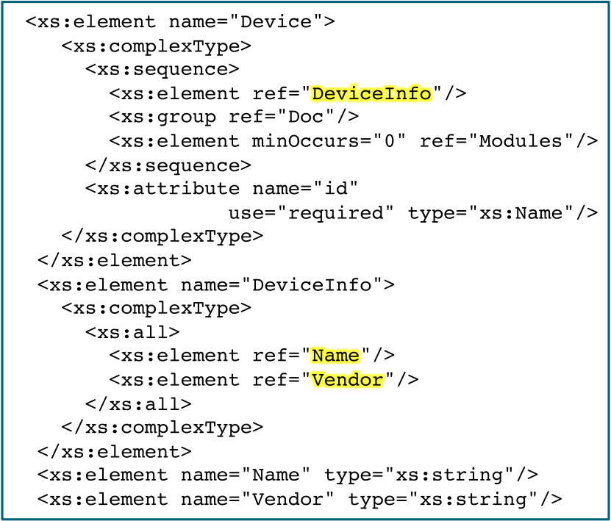
Domain Devices
  Now have all the elements to define a device
Schema
  Consists of
  Some meta-info
    Vendor
    Model
    etc
  Modules section
    Contains Modules
    Not ModuleClasses

Slide 13
Devices Modules
  Device Modules essentially the same a ModuleClasses
Schema
<xs:element name="Modules">
<xs:complexType>
<xs:sequence>
<xs:element minOccurs="0"
maxOccurs="unbounded" ref="Module"/>
</xs:sequence>
</xs:complexType>
</xs:element>
<xs:element name="Module" type="ModuleDef"/>
  Can extend a
  ModuleClasse
  Cannot be extended
  The ModuleClass is the unit of re-use
    Hence the basis of abstraction
  Device Modules can extend standard ModuleClasses
  ModuleClasses can be imported from other domains
    Modules cannot

Slide 14
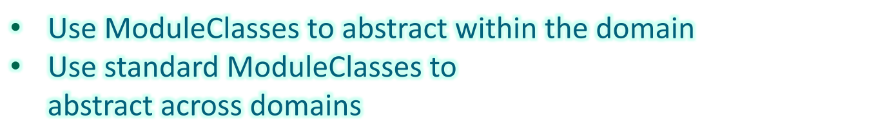
Example Device Modules
  Power – candidate for BooleanState
Document
<Modules>
<Module name="proprietaryPower">
<Actions>
<Action name="on"/>
<Action name="off"/>
<Action name="state" type="string"/>
</Actions>
</Module>
<Module name="power">
<extends domain="hgi.dal.core"
class="BooleanState"/>
</Module>
</Modules>
  Vendor can define „inline“ proprietary modules
  Simpler – reduces
  definition effort
  But little abstraction
Only need hgi-core domain to use power module

Slide 15
Example Device
  A device with a power switch defined by DTAG ...
Document
<?xml version="1.0" encoding="iso-8859-1"?>
<Domain xmlns="http://hgi.org/xml/dal/1.0"
xmlns:xi="http://www.w3.org/2001/XInclude"
id="com.telekom">
<Imports>
<xi:include parse="xml"
href="http://hgi.org/dal-core.xml"/>
</Imports>
<Devices>
<Device id="switch.power">
<DeviceInfo>
<Name>PowerSwitch</Name>
<Vendor>Telekom Laboratories</Vendor>
</DeviceInfo>
<Modules>
see previous slide
</Modules>
</Device>
</Devices>
</Domain>
  Details of device discovery to be determined, but device can be used by applications understanding:
  power
  BooleanState

